Slide 1
Unit III Cloning & System Functions
Chapter 15

Slide 2
Cloning
The object cloning is a way to create exact copy of an object.
For this purpose, clone() method of Object class is used to clone an object.
The java.lang.Cloneable interface must be implemented by the class whose object clone we want to create. If we don't implement Cloneable interface, clone() method generates CloneNotSupportedException.
The clone() method is defined in the Object class. Syntax of the clone() method is as follows:
protected Object clone() throws CloneNotSupportedException

Slide 3
Cloning
Why use clone() method ?
The clone() method saves the extra processing task for creating the exact copy of an object. If we perform it by using the new keyword, it will take a lot of processing to be performed that is why we use object cloning.
Advantage of Object cloning
Less processing task.

Slide 4
Cloning
clone() – Creates a new object and returns a copy of this object.
equals() - Indicates whether some other object is "equal to" this one.
finalize() - Called by the garbage collector on an object when garbage collection determines that there are no more references to the object.
getClass() - Returns the runtime class of an object.
hashCode() - Returns a hash code value for the object.
notify() - Wakes up a single thread that is waiting on this object's monitor.
notifyAll() - Wakes up all threads that are waiting on this object's monitor.
toString() - Returns a string representation of the object.
wait() - Causes current thread to wait until another thread invokes the notify() method or the notifyAll() method for this object

Slide 5
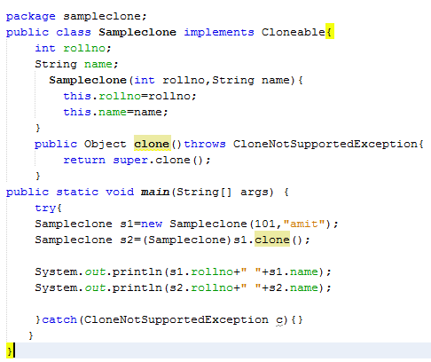
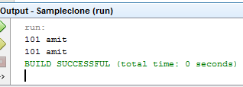

Slide 6
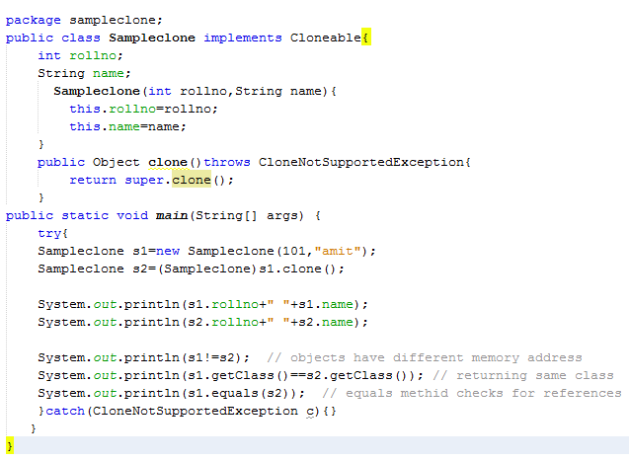
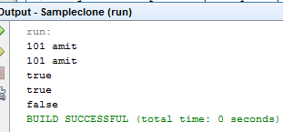

Slide 7
System Functions
The java.lang.System class contains several useful class fields and methods. It cannot be instantiated.
Facilities provided by System:
standard output
error output streams
standard input and access to externally defined properties and environment variables.
A utility method for quickly copying a portion of an array.
a means of loading files and libraries
Class declaration
Following is the declaration for java.lang.System class:
public final class System extends Object

Slide 8
Field
Following are the fields for java.lang.System class:
static PrintStream err -- This is the "standard" error output stream.
static InputStream in -- This is the "standard" input stream.
static PrintStream out -- This is the "standard" output stream.

Slide 9
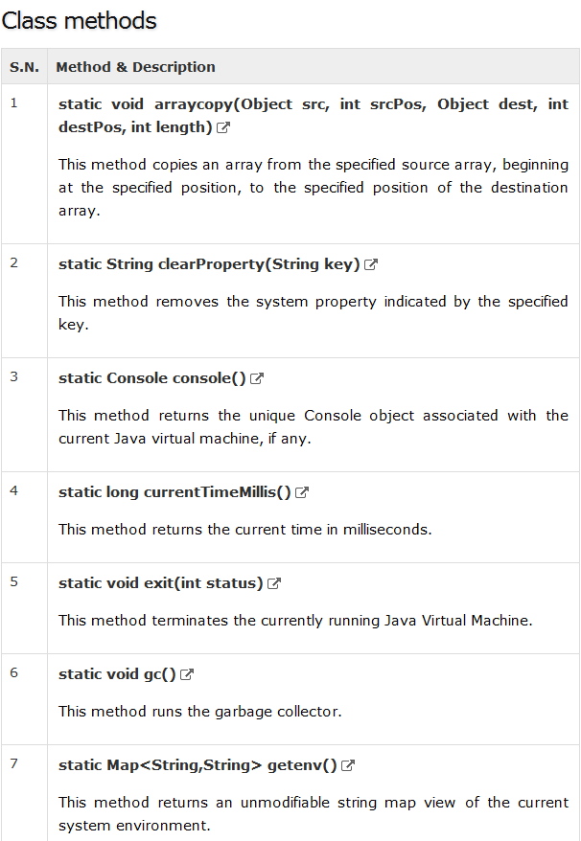

Slide 10
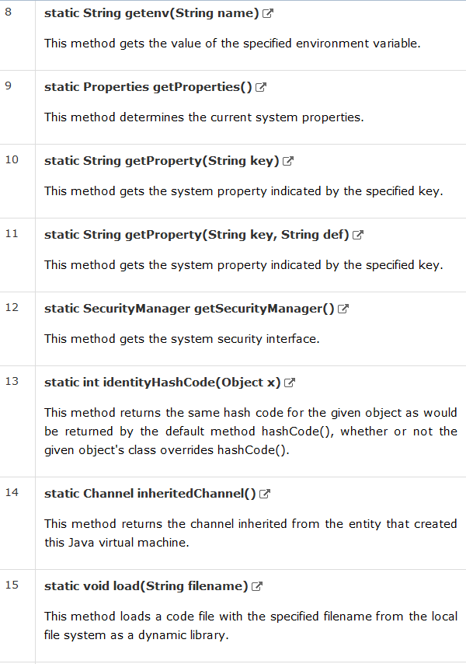

Slide 11
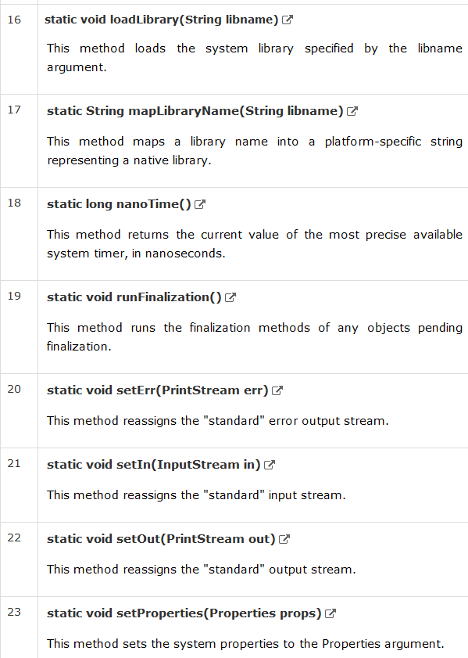

Slide 12
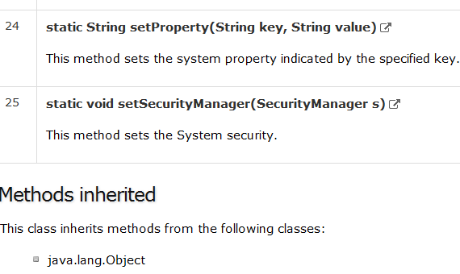

Slide 13
java.lang.System.arraycopy()
Copies an array from the specified source array, beginning at the specified position, to the specified position of the destination array.
The number of components copied is equal to the length argument.
The components at positions srcPos through srcPos + length - 1 in the source array are copied into positions destPos through destPos + length - 1, respectively, of the destination array.
public static void arraycopy(Object src, int srcPos, Object dest, int destPos, int length)

Slide 14
java.lang.System.arraycopy()
Parameters
src -- This is the source array.
srcPos -- This is the starting position in the source array.
dest -- This is the destination array.
destPos -- This is the starting position in the destination data.
length -- This is the number of array elements to be copied.
Return Value
This method does not return any value.

Slide 15
Exception
IndexOutOfBoundsException –
if copying would cause access of data outside array bounds.
ArrayStoreException –
if an element in the src array could not be stored into the dest array because of a type mismatch.
NullPointerException –
if either src or dest is null.

Slide 16
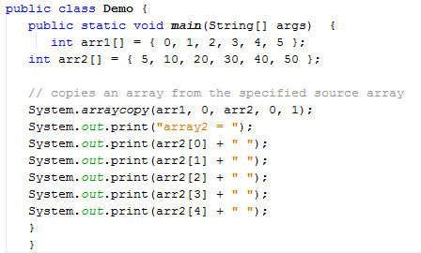


Slide 17
java.lang.System.currentTimeMillis()
The method returns the current time in milliseconds.
public static long currentTimeMillis()
The unit of time of the return value is a millisecond, the granularity of the value depends on the underlying operating system and may be larger.
For example,
many operating systems measure time in units of tens of milliseconds.

Slide 18
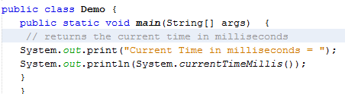
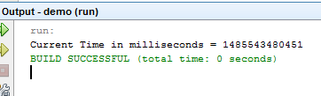

Slide 19
java.lang.System.exit()
The method terminates the currently running Java Virtual Machine.
The argument serves as a status code; by convention, a nonzero status code indicates abnormal termination.
public static void exit(int status)
Parameters
status -- This is the exit status.
Return Value
This method does not return any value.
Exception
SecurityException -- if a security manager exists and its checkExit method doesn't allow exit with the specified status.

Slide 20
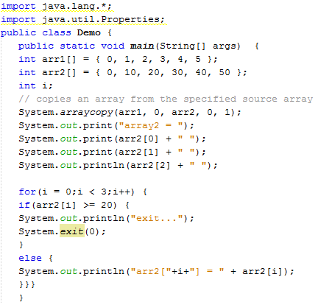
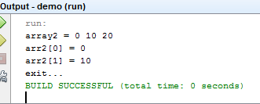

Slide 21
java.lang.System.gc()
The method runs the garbage collector. Calling this suggests that the Java Virtual Machine expend effort toward recycling unused objects in order to make the memory they currently occupy available for quick reuse.
public static void gc()

Slide 22
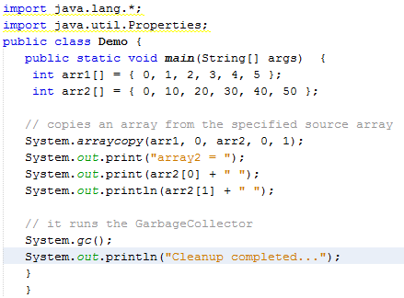
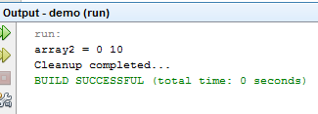

Slide 23
java.lang.System.getProperties()
The java.lang.System.getProperties() method determines the current system properties. The current set of system properties for use by the getProperty(String) method is returned as a Properties object.
If there is no current set of system properties, a set of system properties is first created and initialized. This set of system properties includes values for the following keys:

Slide 24
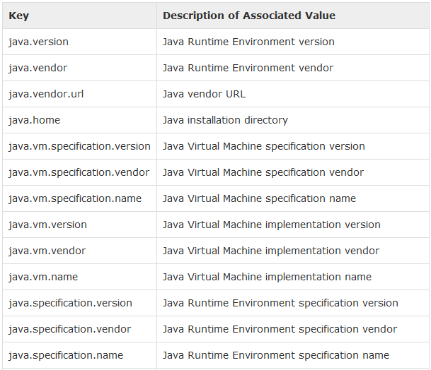

Slide 25
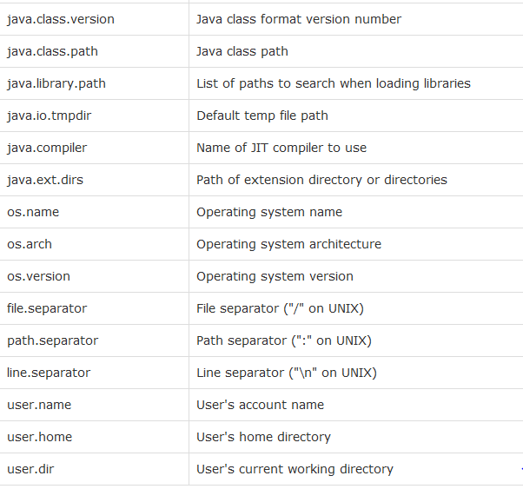

Slide 26
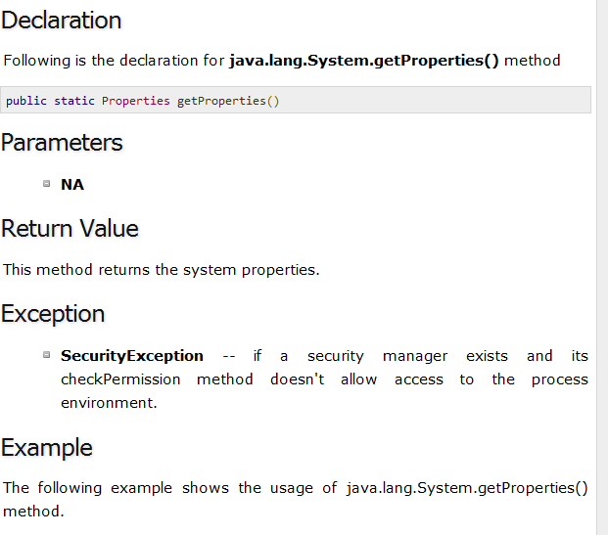

Slide 27
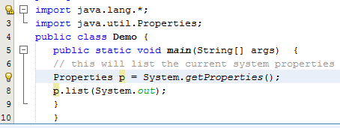
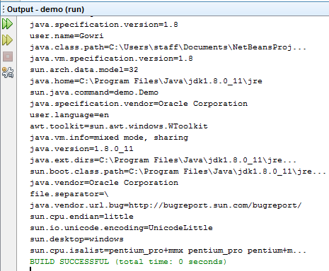

Slide 28
java.lang.System.getProperty(String key)
The method gets the system property indicated by the specified key.
public static String getProperty(String key)
Parameters
key -- This is the name of the system property.
Return Value
This method returns the string value of the system property, or null if there is no property with that key.
Exception
SecurityException -- if a security manager exists and its checkPropertyAccess method doesn't allow access to the specified system property.
NullPointerException -- if key is null.
IllegalArgumentException -- if key is empty.

Slide 29
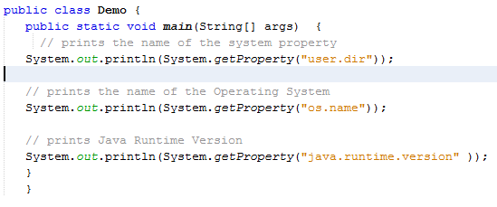
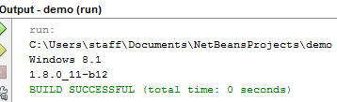

Slide 30
java.lang.System.identityHashCode()
The method returns the same hash code for the given object as would be returned by the default method hashCode(). The hash code for the null reference is zero.
public static int identityHashCode(Object x)
Parameters
x -- This is the object for which the hashCode is to be calculated.
Return Value
This method returns the hashCode.
Exception
NA

Slide 31
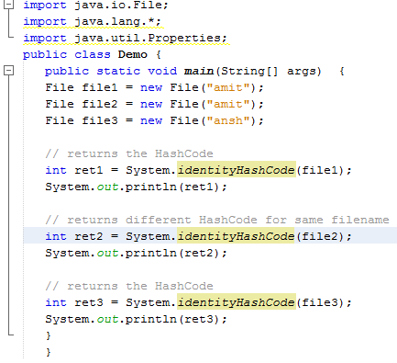
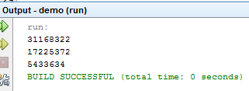

Slide 32
java.lang.System.load()
The method loads a code file with the specified filename from the local file system as a dynamic library. The filename argument must be a complete path name.
public static void load(String filename)
Parameters
filename -- This is the file to load.
Return Value
This method does not return any value.
Exception
SecurityException -- if a security manager exists and its checkLink method doesn't allow loading of the specified dynamic library.
UnsatisfiedLinkError -- if the file does not exist.
NullPointerException -- if filename is null

Slide 33
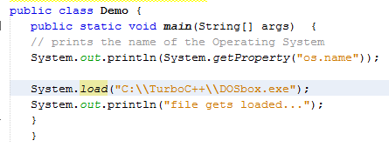
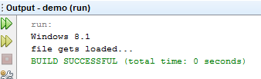

Slide 34
java.lang.System.nanoTime()
The method returns the current value of the most precise available system timer, in nanoseconds. The value returned represents nanoseconds since some fixed but arbitrary time (in the future, so values may be negative) and provides nanosecond precision, but not necessarily nanosecond accuracy.
public static long nanoTime()
Parameters
NA
Return Value
This method returns the current value of the system timer, in nanoseconds.
Exception
NA

Slide 35
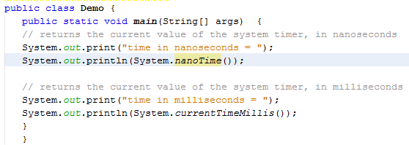


Slide 36
java.lang.System.setErr()
The method reassigns the "standard" error output stream.
public static void setErr(PrintStream err)
Parameters
err -- This is the new standard error output stream.
Return Value
This method does not return any value.
Exception
SecurityException -- if a security manager exists and its checkPermission method doesn't allow reassigning of the standard error output stream.

Slide 37
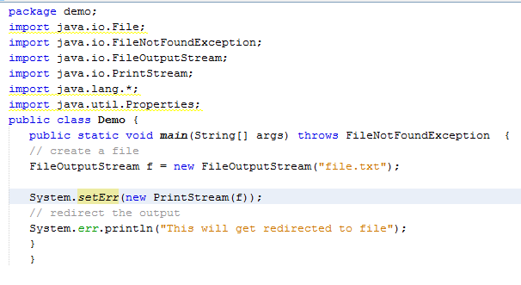
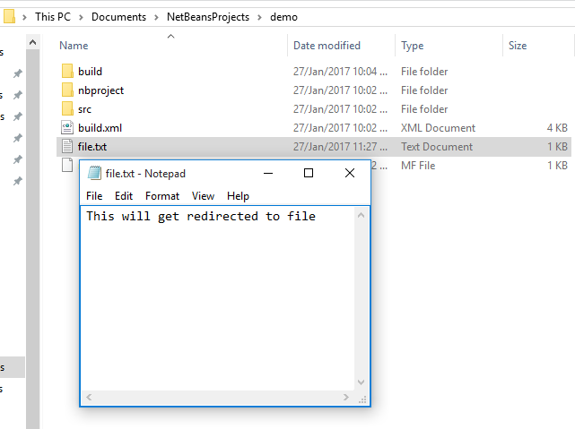


Slide 38
java.lang.System.setIn()
The method reassigns the "standard" input stream
public static void setIn(InputStream in)
Parameters
in -- This is the new standard input stream.
Return Value
This method does not return any value.
Exception
SecurityException -- if a security manager exists and its checkPermission method doesn't allow reassigning of the standard input stream.

Slide 39
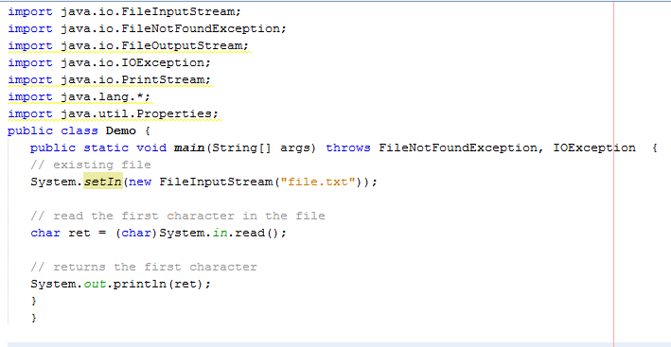
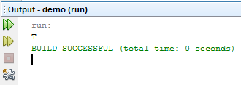

Slide 40
java.lang.System.setOut()
The method reassigns the "standard" output stream.
public static void setOut(PrintStream out)
Parameters
out -- This is the standard output stream.
Return Value
This method does not return any value.
Exception
SecurityException -- if a security manager exists and its checkPermission method doesn't allow reassigning of the standard output stream.

Slide 41
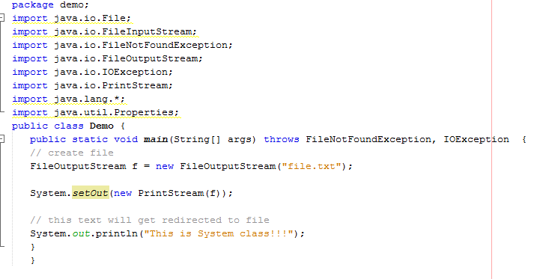
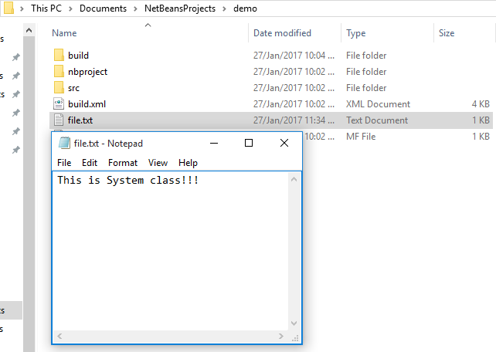


Slide 42
Thank You

